Slide 1
Ensemble
Part 1: Ensemble Overview

Slide 2
What problem does Ensemble solve?
Example ER Visit
Bob has chest pains, calls 911, and is rushed to the ER
Bob is identified and his visit is logged
ER Doctors perform procedures and order X-Rays, Lab tests, and medications
Bob is admitted
Inpatient doctors place more orders
Bob is discharged

Slide 3
What problem does Ensemble solve?
Typical hospital software
REG
SOAP
ER
ADM
TCP
File
EMR
FTP
ORD
ER: Emergency Department
FTP
NUR
REG: Registration
TCP
EMR: Electronic Medical Rec.
MED
ORD: Ordering
SOAP
MED: Medications
RAD
RAD: Radiology
HTTP
LAB: Laboratory
ADM: Admissions
LAB
NUR: Inpatient/Nursing
TCP
Notes:
Each arrow represents a program that must be written to handle communications between the two applications on either side of the arrow.

Slide 4
What problem does Ensemble solve?
The Ensemble Way
ADM
EMR
ER
NUR
REG
HealthConnect
ORD
RAD
MED
LAB

Slide 5
What problem does Ensemble solve?
Example
?
ER
TCP
SOAP
REG
Receive
Transform
Send
Notes:
Consume incoming data from the upstream system (ER in this case)
Transform the data to the format expected by the downstream system (REG)
Send the data to the downstream system (REG)

Slide 6
What problem does Ensemble solve?
Example
?
ER
TCP
SOAP
REG
Listen on TCP Socket
Accept connections
Receive data
Verify data
Transform data
Generate SOAP message
Connect to HTTP Server
Send SOAP message
Error handling, logging, retry, configurable settings, etc
Receive
Transform
Send
Notes:
This is the overview of the code that must be written for ONE connection. This must be repeated for every connection, so every arrow from the first diagram.

Slide 7
What problem does Ensemble solve?
Example
ER
TCP
Ensemble
SOAP
REG
Listen on TCP Socket
Accept connections
Receive data
Verify data
Transform data
Generate SOAP message
Connect to HTTP Server
Send SOAP message
Error handling, logging, retry, configurable settings, etc
Receive
Transform
Send
Notes:
When you use Ensemble to handle these connections, most of the work is already done for you by standard components supplied with Ensmeble.

Slide 8
How does Ensemble Work?
Overview
ER
TCP
Ensemble
SOAP
REG
Receive
Transform
Send
Notes:
In Ensemble, all messages related to one Receive->Transform->Send path through the production are considered to be part of the same “Session”
So a “Session” contains all internal messages that originated from one individual incoming external message.

Slide 9
How does Ensemble Work?
Overview
ER
TCP
Ensemble
SOAP
REG
Raw TCP Data
TCP Inbound Adapter
SOAP Outbound Adapter
SOAP message
Ensemble Message
Ensemble Message
Business Service
Business Process
Business Operation
Receive
Transform
Send
Notes:
In Ensemble:
Services handle the receive portion
Processes handle the transform portion
Operations handle the send portion

Slide 10
How does Ensemble Work?
Overview
Raw TCP Data
SOAP message
TCP Inbound Adapter
SOAP Outbound Adapter
Ensemble Message
Ensemble Message
Business Service
Business Process
Business Operation
Listen on TCP Socket (Inbound Adapter)
Accept connection (Inbound Adapter)
Receive data (Inbound Adapter)
Verify data (Service)
Transform data (Business Process)
Generate SOAP message (Operation)
Connect to HTTP Server (Outbound Adapter)
Send SOAP message (Outbound Adapter)
Error handling, logging, retry, configurable settings, etc (Everything)
Receive
Transform
Send
Notes:
Which parts of the “connection” program are handled by which Ensemble components

Slide 11
How does Ensemble Work?
Production
Raw TCP Data
TCP Inbound Adapter
SOAP Outbound Adapter
SOAP message
Ensemble Message
Ensemble Message
Business Service
Business Process
Business Operation
File
FTP Inbound Adapter
Ensemble Message
Business Service
File
File Inbound Adapter
FTP Outbound Adapter
File
Ensemble Message
Ensemble Message
Business Service
Business Process
Business Operation
HTTP Request
HTTP Outbound Adapter
Business Operation
Notes:
Services, Processes, and Operations are organized into what we call “Productions”.
A component can only send an internal ensemble message to another component in the same production.
Each component will have its own process.

Slide 12
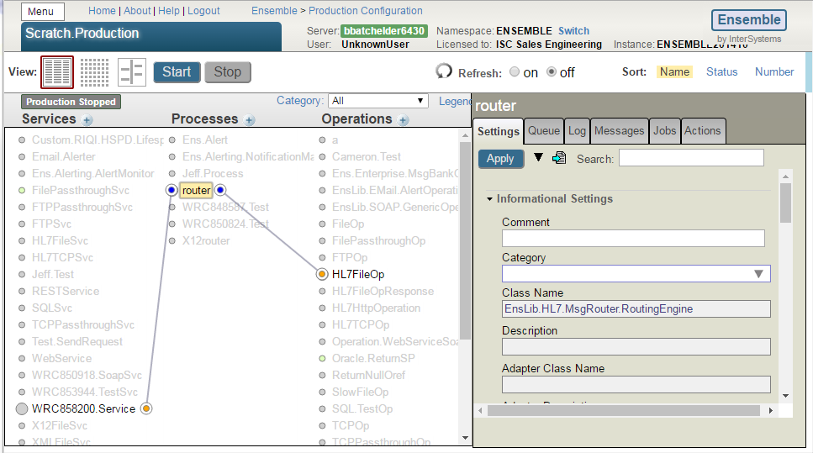
How does Ensemble Work?
Production
Notes:
This is the production configuration page, showing columns for services, processes, operations.
Clicking a circle will draw the lines showing connections

Slide 13
How does Ensemble Work?
Starting a Production (The Ensemble Framework)
Start
OnTask()
Ens.Director method StartProduction
Service
Process
Operation
Call Adapter’s OnTask()
Call Ens.Queue method Dequeue()
Call Ens.Queue method Dequeue()
Foreach component
OnTask() calls Service OnProcessInput()
Pass to Business Process MessageHeaderHandler()
Pass to Operation MessageHeaderHandler()
Job Ens.Job method Start()
User Code
Pass to OnRequest(), OnResponse() or OnError()
Pass to method specified by MessageMap
Instantiate component class, call OnInit()
User Code
User Code
Loop calling OnTask()
Notes:
This is the code path Ensemble takes to get to user code. Everything before User Code should work fine, and so the only part you would ever be interested is the User Code portion.
Ens.Director StartProduction
Loop:
Ens.Job Launch
Job StartEnsembleJob^STU(tCurrentNS,pConfigName,pDisableErrorTraps,0,0,pInterimJob)
d ##class(Ens.Job).Start(pConfigName,pDisableErrorTraps,pIsTempJob,pForeground,pInterimJob,.pEventName)
In ##class(Ens.Job).Start:
$$$sysTRACE("Starting job for config item '"_pConfigName_"', classname '"_tClassName_"'")
$$$sysTRACE("Calling Register()")
Set tInstance=$classmethod(tClassName,"%New",pConfigName) If '$IsObject(tInstance) { Set tSC=%objlasterror Quit }
; tClassName will be a subclass of Ens.Host
$$$LOGINFO("ConfigItem '"_pConfigName_"' "_$S(pConfigName=tClassName:"",1:"("_tClassName_") ")_"started in job "_tJob) Do ..SetStatus($$$eJobStatusRunning)
$$$sysTRACE("Entering OnTask() loop")
Loop:
tSC=tInstance.OnTask()
OnTask:
Services: Call Adapter.OnTask. Adapter.OnTask will call OnProcessInput when there is Input. OnProcessInput is where user code begins.
Processes and Operations: Call Ens.Queue method Dequeue to get next message then pass it to MessageHeaderHandler.
MessageHeaderHandler:
Processes: Call OnRequest, OnResponse or OnError as appropriate, which is where user code begins
Operations: Call MessageHandler, which delegates to a custom method based on MessageMap. That custom method is where user code begins.

Slide 14
How does Ensemble work?
Business Services and Inbound Adapters
ER
TCP
Ensemble
SOAP
REG
Raw TCP Data
TCP Inbound Adapter
SOAP Outbound Adapter
SOAP message
Ensemble Message
Ensemble Message
Business Service
Business Process
Business Operation

Slide 15
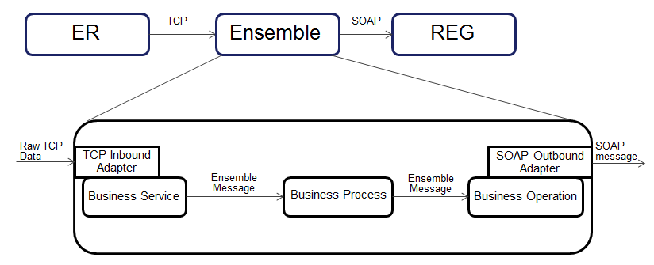
How does Ensemble work?
Business Services and Inbound Adapters
1
2
Raw TCP Data
TCP Inbound Adapter
3
4
Ensemble Message
Business Service
Inbound Adapters extend Ens.InboundAdapter
Business Services extend Ens.BusinessService
OnInit() in Adapter called on component start by Ensemble framework
OnTask() in Adapter called periodically by Ensemble framework
OnTask() calls OnProcessInput() in Service when there is data
User Code: OnProcessInput() uses ..SendRequestAsync() to send message objects to target component
Notes:
The Inbound Adapter is a class (EnsLib.TCP.InboundAdapter in this case) which extends Ens.InboundAdapter and must define methods OnInit and OnTask.
The business service is a separate class which extends Ens.BusinessService and must define method OnProcessInput.
When the component is started, the Ensemble Framework calls OnInit in the adapter (in this case, that starts a TCP listening socket).
The Ensemble Framework calls OnTask periodically in the adapter until it detects incoming data.
OnTask converts the incoming data into some Cache format (such as a stream) and passes it to method OnProcessInput in the business service.
Method OnProcessInput is responsible for converting the data to a message object (such as Ens.StreamContainer or anything %Persistent) and sending it to the next component with method ..SendRequestAsync or ..SendRequestSync. In custom-coded business services, this is the only part the customer needs to code.

Slide 16
How does Ensemble work?
Ensemble Messages
ER
TCP
Ensemble
SOAP
REG
Raw TCP Data
TCP Inbound Adapter
SOAP Outbound Adapter
SOAP message
Ensemble Message
Ensemble Message
Business Service
Business Process
Business Operation
Notes:
Ensemble messages are how Ensemble components communicate with each other internally.

Slide 17
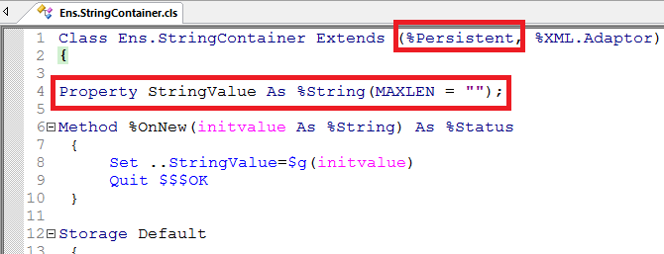
How does Ensemble work?
Ensemble Messages
%Persistent
Properties and Methods
..SendRequestSync()/..SendRequestAsync()
Notes:
Any %Persistent class can be used as a message class
Message classes can have properties and methods just like any other class.
There is nothing special about a message class – if you pass an object to ..SendRequestAsync() or ..SendRequestSync() then it is considered a message.
Sync means wait for a response before continuing execution. Async means don’t wait.

Slide 18
How does Ensemble work?
What really happens when you SendRequestAsync?
ER
TCP
Ensemble
SOAP
REG
Raw TCP Data
TCP Inbound Adapter
SOAP Outbound Adapter
SOAP message
Ensemble Message
Ensemble Message
Business Service
Business Process
Business Operation

Slide 19
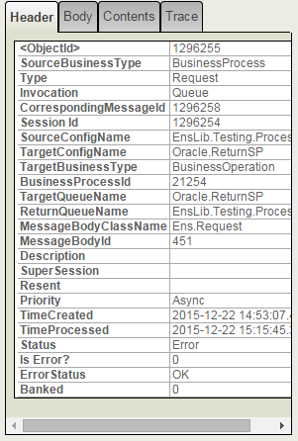
How does Ensemble work?
Ensemble Message Headers
Generated automatically by ..SendRequestAsync()
Analogous to an Envelope
Source, Target
Timestamped
Status
Message Body is the “letter”

Slide 20
How does Ensemble work?
SendRequestAsync
SendRequestAsync
SourceName
DateTime
Other data
1
^Ens.Queue(TargetName)
5
TargetName
3
New Header
(Ens.MessageHeader)
%Status
4
Message
2
%Save
SendRequestAsync called with Target and Message
The message object is %Saved.
Header Created with Body, Source, Target, Date/Time
Header added to queue of target component
SendRequestAsync returns a %Status
Notes:
Some component calls SendRequestAsync, passing a message object and the name of the target component.
The message object is %Saved.
A Message Header is created. It contains a pointer to the message, the source and target component names, the current DateTime, and other data.
The message header ID is added to the end of the queue for the target component. (^Ens.Queue(TargetName))
SendRequestAsync returns a %Status
Queue: First in first out collection

Slide 21
How does Ensemble work?
Business Processes
ER
TCP
Ensemble
SOAP
REG
Raw TCP Data
TCP Inbound Adapter
SOAP Outbound Adapter
SOAP message
Ensemble Message
Ensemble Message
Business Service
Business Process
Business Operation

Slide 22
How does Ensemble Work?
Business Processes
Ensemble Message
3
1
2
Ensemble Message
Business Process
Business Processes extend Ens.BusinessProcess.
Graphical BPL Editor or custom-coded in studio.
Previous ..SendRequestAsync() put message header onto queue
OnRequest() called when message dequeued by Ensemble framework
User Code: OnRequest() does work and calls ..SendRequestAsync()
Notes:
A Business Process is a class which extends Ens.BusinessProcess and must define method OnRequest. These are typically created with the graphical BPL editor, but can also be custom-coded in studio.
Some other component used method ..SendRequestAsync or ..SendRequestSync to send a message to this component. That message is put into the queue for this component (stored in ^Ens.Queue).
The Ensemble Framework continuously checks this queue (‘dequeueing’) and passes the top message to method OnRequest in the Business Process.
The Business Process does any work it needs to do (usually transforming the message from one format to another format) and then sends a message to the next component using ..SendRequestAsync or ..SendRequestSync.

Slide 23
How does Ensemble work?
Business Operations and Outbound Adapters
ER
TCP
Ensemble
SOAP
REG
Raw TCP Data
TCP Inbound Adapter
SOAP Outbound Adapter
SOAP message
Ensemble Message
Ensemble Message
Business Service
Business Process
Business Operation

Slide 24
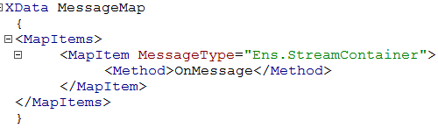
How does Ensemble work?
Business Operations
SOAP Outbound Adapter
SOAP message
1
3
Ensemble Message
2
Business Operation
Outbound Adapters extend Ens.OutboundAdapter
Business Operations extend Ens.BusinessOperation.
Previous ..SendRequestAsync() put message into queue
Dequeued message passed to method specified by MessageMap
User Code: Operation method uses adapter methods to output data
Notes:
A Business Operation is a class which extends Ens.BusinessOperation. It must define an XData MessageMap block along with the Methods in the MessageMap.
Some other component used method ..SendRequestAsync() or ..SendRequestSync() to send a message to this component. That message is put into the queue for this component (stored in ^Ens.Queue).
The Ensemble Framework continuously checks this queue (‘dequeueing’). When it finds a message, it checks the type of that message and then consults the MessageMap to see which method it should pass the message to based on its type.
The Business Operation method uses adapter methods to output the data. Adapter methods are specific to the adapter, such as Get() and Post() methods for the HTTP outbound adapter, or PutLine(), PutString(), PutStream() for the File outbound adapter.

Slide 25
Questions?

